Slide 1

Stucco Collecting and Organizing Security Data for Contextual Understanding
2016 | Cyber Security Division
IMAM Mid Term Meeting
Robert Bridges & Mike Iannacone Oak Ridge National Laboratory
2017-01-30

Slide 2




Team Profile

Slide 3
Need
[**] 1:234:56 IRC - Channel JOIN [**]
[Classification: A Network Trojan was detected]
09/04-17:11:45.456789
10.32.92.230:6667 -> 69.42.215.170:33982 {TCP}
This is only a starting point…
Additional context is required to determine an event’s impact
TTL: 34 TOS:0x0 ID:3456 IpLen:20 DgmLen: 44 ******S*
Seq: 0x12345678 Ack: 0x0 Win: 0x400
TcpLen: 24 TCP Options (1) => MSS: 1440
[Xref => http://cve.mitre.org/CVE-2002-1675]
Notes:
Security analysts have a variety of different automated systems to assist them in keeping networks safe.
- Host based intrusion detection
- NIDs
- Firewalls
- various logs, ..
But a large amount of manual investigations that are undertaken in order to make sense of their data.
Typical example, here. can see a little bit of information - IRC...

Slide 4
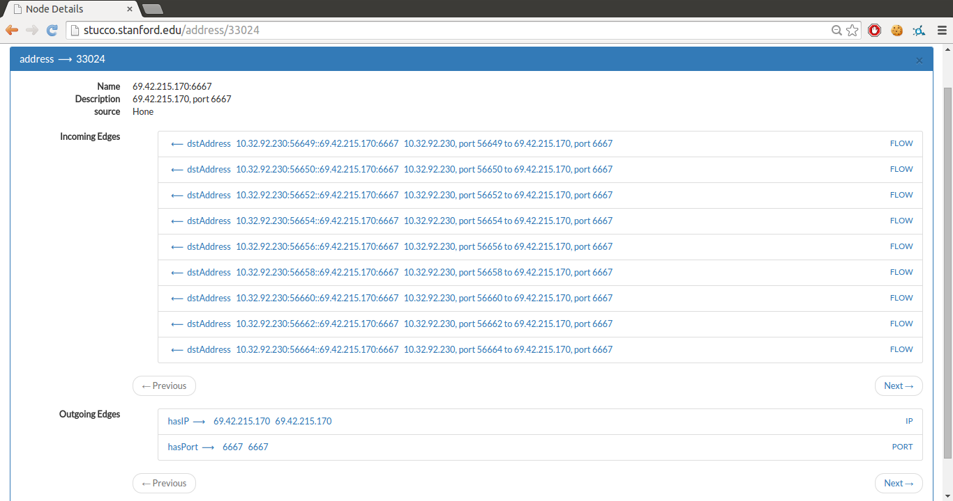
Stucco Approach
Continuously collect data from enterprise and open sources
Extract domain information from structured (e.g. STIX) and unstructured data sources
Align data into a knowledge graph, merging data rather than adding duplicate data
Provide an API for programmatic access and a user interface for exploring the graph

Slide 5
Sample of Data Sources
Observables
Network flows (Argus)
Process → Port (Hone)
User logins (auth.log)
Package list (deb)
GeoIP (Maxmind)
AS mapping (CAIDA)
Software (CPE)
Exploit targets
Vulnerabilities (NVD, Bugtraq, Metasploit)
Tactics, Techniques, Procedures (TTPs)
Exploits (Metasploit)
Malware (F-Secure, Emerging Threats, 1d4, Zeus Tracker)
Virus (CleanMX, Sophos)
Indicators
Attacker IPs (Malware domain list, Sophos)
Course of Action
Remediation (Bugtraq)
Notes:
Collectors: RSS, web scraping, file downloads

Slide 6
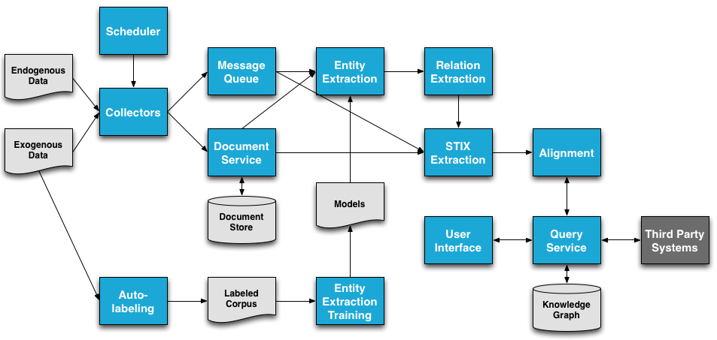
Architecture Overview

Slide 7
Structured Data (small messages)

Slide 8
Structured Data (large messages)

Slide 9
Unstructured Data

Slide 10
Try it out
Use the demonstration instance
http://stucco.stanford.edu/
Run a pre-configured demonstration VM
Build your own VM or install on a local cluster
Vagrant.configure(2) do |config|
config.vm.box = "stucco/demo”
config.vm.network "forwarded_port", guest: 8000, host: 8000
config.vm.synced_folder ".", "/vagrant", disabled: true
end
$ vagrant up
https://stucco.github.io/

Slide 11
Current Status
Fully working prototype: https://stucco.github.io/
Ability to populate graph with
Any STIX data with no configuration required
Other structured data with configuration
Unstructured document sources
Uses a stable storage backend (PostgreSQL) for the knowledge graph
User interface for searching this graph
Currently focused on incident response use case
Notes:
Idea is to click link and start the build– encourage others to see set it up.
Need to update bullets

Slide 12
Progress Overview
STIX Completion
Knowledge Graph Storage
User Interface
Packaging and Releases
Natural Language Processing
Notes:
Delete/integrate w/ pvs slide

Slide 13
(New) UI Framework

Slide 14
Pilot DOE Deployment
Blah
Also Scalability + Performance tests

Slide 15
STIX Integration (Exporting STIX)
STIX is now used throughout Stucco
Replaces our old ontology
Any valid STIX document can be normalized and processed through our pipeline
No configuration is needed
All current structured and unstructured sources are converted to STIX before use
Notes:
New bullet:
Stix import was supported lsat summer
Now can export stixs !!
--Masha’s bullets/ details?
--

Slide 16
ElasticSearch Compatability (In Progress)

Slide 17
Relation Extraction Integration

Slide 18
Viz stuff (John + Amy)

Slide 19
Next Steps – Stucco 2.0

Slide 20


STIX Normalization
<stix:TTP xmlns:xsi="http://www.w3.org/2001/XMLSchema-instance" id="stucco:malware-29ca0280-a655-49c0-8cf9-234935bab598" xsi:type="ttp:TTPType">
<ttp:Title>Malware</ttp:Title>
<ttp:Behavior>
<ttp:Malware>
<ttp:Malware_Instance id="stucco:malware-botnet">
<ttp:Type>Botnet</ttp:Type>
<ttp:Name>Botnet</ttp:Name>
<ttp:Title>Botnet</ttp:Title>
<ttp:Description>Botnet</ttp:Description>
</ttp:Malware_Instance>
</ttp:Malware>
</ttp:Behavior>
<ttp:Resources>
<ttp:Infrastructure>
<ttp:Observable_Characterization cybox_major_version="2.0" cybox_minor_version="1.0">
<cybox:Observable>
<cybox:Title>IP</cybox:Title>
<cybox:Observable_Source>
<cyboxCommon:Information_Source_Type>zeustracker.abuse.ch</cyboxCommon:Information_Source_Type>
</cybox:Observable_Source>
<cybox:Object id="stucco:ip-1694521603">
<cybox:Description>101.0.89.3</cybox:Description>
<cybox:Properties category="ipv4-addr" xsi:type="AddressObj:AddressObjectType">
<AddressObj:Address_Value>101.0.89.3</AddressObj:Address_Value>
</cybox:Properties>
</cybox:Object>
</cybox:Observable>
</ttp:Observable_Characterization>
</ttp:Infrastructure>
</ttp:Resources>
</stix:TTP>

Slide 21
STIX Normalization
<cybox:Observable id="stucco:ip-89992030-5378-4711-bcfe-6e5b1dc59f2f">
<cybox:Title>IP</cybox:Title>
<cybox:Observable_Source>
<cyboxCommon:Information_Source_Type>zeustracker.abuse.ch</cyboxCommon:Information_Source_Type>
</cybox:Observable_Source>
<cybox:Object id="stucco:ip-1694521603">
<cybox:Description>101.0.89.3</cybox:Description>
<cybox:Properties xmlns:xsi="http://www.w3.org/2001/XMLSchema-instance" category="ipv4-addr" xsi:type="AddressObj:AddressObjectType">
<AddressObj:Address_Value>101.0.89.3</AddressObj:Address_Value>
</cybox:Properties>
</cybox:Object>
</cybox:Observable>
<stix:TTP xmlns:xsi="http://www.w3.org/2001/XMLSchema-instance"
id="stucco:malware-f162c851-6138-4544-b149-105a23676c3e" xsi:type="ttp:TTPType">
<ttp:Title>Malware</ttp:Title>
<ttp:Behavior>
<ttp:Malware>
<ttp:Malware_Instance id="stucco:malware-botnet">
<ttp:Type>Botnet</ttp:Type>
<ttp:Name>Botnet</ttp:Name>
<ttp:Title>Botnet</ttp:Title>
<ttp:Description>Botnet</ttp:Description>
</ttp:Malware_Instance>
</ttp:Malware>
</ttp:Behavior>
<ttp:Resources>
<ttp:Infrastructure>
<ttp:Observable_Characterization cybox_major_version="2.0" cybox_minor_version="1.0">
<cybox:Observable idref="stucco:ip-89992030-5378-4711-bcfe-6e5b1dc59f2f"/>
</ttp:Observable_Characterization>
</ttp:Infrastructure>
</ttp:Resources>
</stix:TTP>

Slide 22


STIX Normalization
Vertex
<campaign:Campaign xmlns:campaign="http://stix.mitre.org/Campaign-1" xmlns:stixCommon="http://stix.mitre.org/common-1" xmlns:stucco="gov.ornl.stucco" xmlns:ta="http://stix.mitre.org/ThreatActor-1" id="stucco:campaign-a2dec921-6a3f-49e4-b415-402b376fff5c">
<campaign:Title>Compromise of ATM Machines</campaign:Title>
<campaign:Description>Compromise of ATM Machines on May 23, 2015 at Chicago Main ave.</campaign:Description>
<campaign:Names>
<campaign:Name>Black Star</campaign:Name>
</campaign:Names>
<campaign:Attribution>
<campaign:Attributed_Threat_Actor>
<stixCommon:Threat_Actor xmlns:xsi="http://www.w3.org/2001/XMLSchema-instance" idref="stucco:threat-9f055e12-d799-47d8-84a5-f018ee1ccb99" xsi:type="ta:ThreatActorType"/>
</campaign:Attributed_Threat_Actor>
</campaign:Attribution>
<campaign:Information_Source>
<stixCommon:Identity>
<stixCommon:Name>CNN</stixCommon:Name>
</stixCommon:Identity>
</campaign:Information_Source>
</campaign:Campaign>
Edge
<ta:Threat_Actor xmlns:stixCommon="http://stix.mitre.org/common-1" xmlns:stucco="gov.ornl.stucco" xmlns:ta="http://stix.mitre.org/ThreatActor-1" id="stucco:threat-9f055e12-d799-47d8-84a5-f018ee1ccb99">
<ta:Title>People behind the intrusion</ta:Title>
<ta:Identity>
<stixCommon:Name>Patric Black</stixCommon:Name>
<stixCommon:Related_Identities>
<stixCommon:Related_Identity>
<stixCommon:Identity>
<stixCommon:Name>Joel Travis</stixCommon:Name>
</stixCommon:Identity>
</stixCommon:Related_Identity>
</stixCommon:Related_Identities>
</ta:Identity>
</ta:Threat_Actor>
Vertex

Slide 23
STIX 2.0
Many significant improvements planned in the upcoming 2.0 standard
“Less flexibility, more standardization”
“2.0 is explicitly graph-based”
“CybOX will have fewer objects that are better developed and more focused”
Planned changes address many of the issues we have encountered
Cannot transition until standard is finalized and libraries are updated

Slide 24
Knowledge Graph Store
Developed a graph DB abstraction layer – a common interface for any supported DB
Adding new implementation is reasonably simple
Developed a rest service based on this
Used by the user interface
Exposed to external applications
Currently have implementations for: OrientDB, Titan, Postgres, and in-memory

Slide 25
User Interface
User interface updated to generate STIX reports
Optionally displays raw STIX for any item
Migrating from Ampersand to React framework
More Modular
Larger developer community
Core Ampersand developers also migrating
Notes:
Redo to include User Interface updates

Slide 26
Unstructured Document Pipeline
Documents are parsed
Word & sentence tokenized
Part of speech tags
Parse trees parsing
Entities Labeled
Heuristic labels applied
Maximum entropy model
Relation Extraction
“[sw.vendor_Microsoft] released 11 security updates to fix vulnerabilities more than 40 flaws in [sw.product_Windows] and related software”
“[sw.vendor_Adobe] has pushed out a critical update to plug at least 52 security holes in its widely-used [sw.product_Flash] browser plugin”
Extract:
[sw.vendor_Microsoft] is_vendor_of
[sw.product_Windows]
Extract:
[sw.vendor_Adobe] is_vendor_of
[sw.product_Flash]

Slide 27
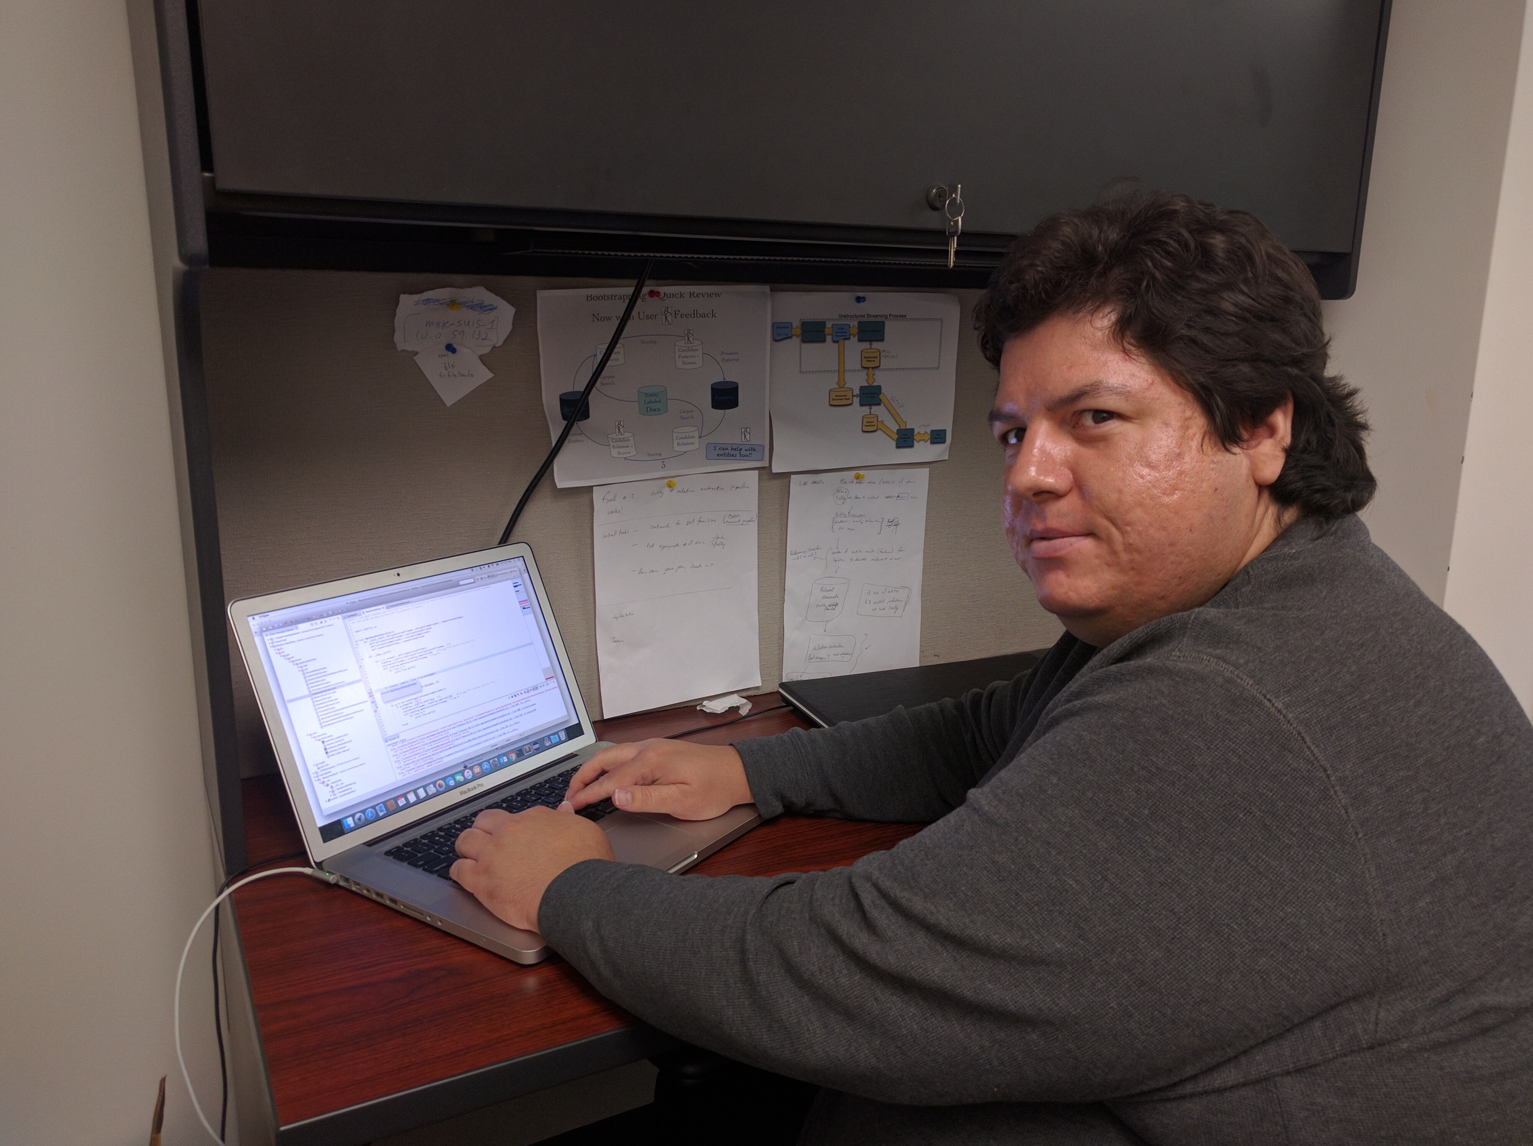
Relation Extraction Components
Collection of large set of security documents
Replace named entities with a string representative
”Adobe issued …” → ”[sw.vendor_Adobe] issued …”
Word2Vec used for contextual embedding of words
Semantic (not syntactic) word representatives
Corpus of positive and negative relation examples created from structured and unstructured sources
Leverage known data to make a training corpus
Supervised learning for binary classification
Input: Sentence with entity pair identified
Output: Relation exists or not
The work mainly of Isaac Persing, DHS-STEM Intern, ABT NLP
Software engineering and mentorship via Kelly
Planning and math mentorship by Bobby

Slide 28
Document Collection Pipeline
Pieces assembled, debugged, and working!
174 docs collected in first 5 hours from up to 42 URLs

Slide 29
Replace Entities with Representative
Expected Benefits:
Canonicalization: alias resolution
Example: IE and Internet Explorer known to be the same
Leveraging Freebase currently
All entities are now a single token
Adobe issued a critical update for its ubiquitous Flash Player software.
to
[sw.vendor_Adobe] issued a critical update for its [sw.product_Flash_Player] software

Slide 30
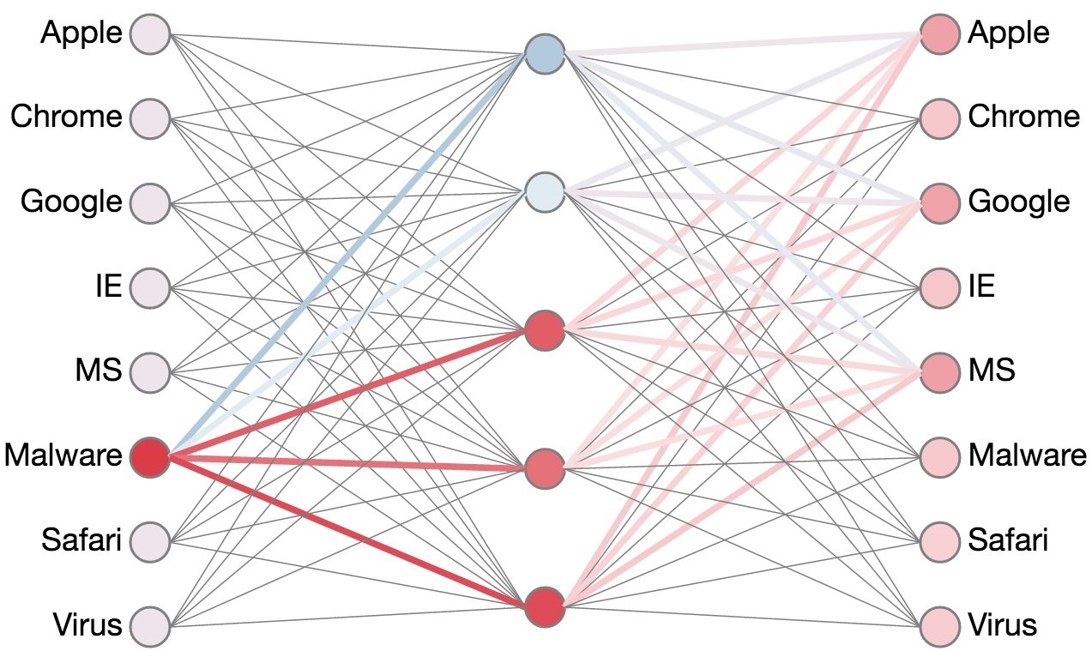
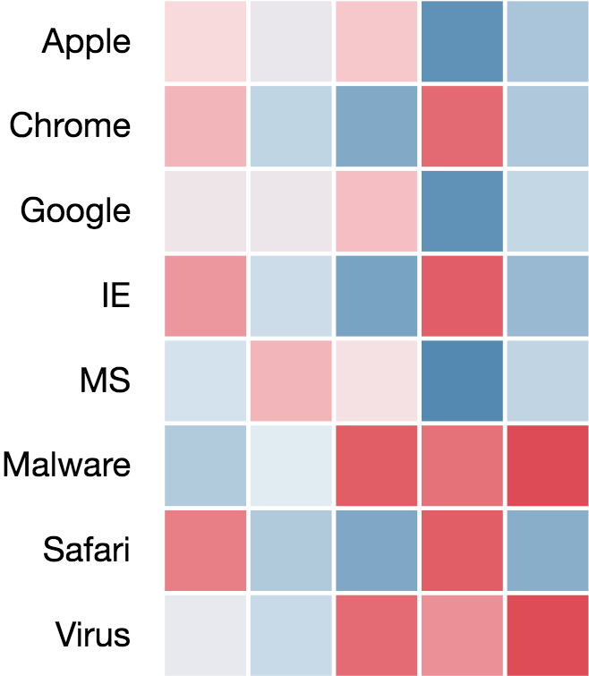
What is Word2vec?
Semantically similar words have similar context (surrounding words)
Train a neural net on many documents
Input: a word
Output prediction: word’s context
After training, semantically similar words have similar feature vector representations
Vectors after training
Simple Neural Net
Image credit: https://ronxin.github.io/wevi/

Slide 31
Word2Vec: How We Use It
Train word2vec model on:
7 million Wikipedia articles.
Security documents oversampled 100 times.
100 hidden units
Skip grams with 5 word context window
Vocabulary words must occur > 100 times
Training takes 5 days with 7 2.5 GHz cores, but only has to be done once
Word2Vec feature representation stored for each word, i.e., we have a key-value store of the form
Word : Feature Vector
Python Gensim Reference: Řehůřek, R., and P. Sojka. "Gensim–Python Framework for Vector Space Mo delling." NLP Centre, Faculty of Informatics, Masaryk University, Brno, Czech Republic (2011).

Slide 32
Leveraging Known Relations
From NVD, Freebase we identify entity pairs
Known to share a (fixed) relation
E.g. Microsoft Office, Adobe Flash Player
Known not to share a (fixed) relation
E.g. Adobe Office
From text if a sentence has an entity pair
Known to share the relation, label sentence “1”
Known not to share the relation, label sentence “-1”
Could, but is unknown if they share the relation, label sentence “0”
Examples
“[sw.vendor_Adobe] has pushed out a critical update to plug at least 52 security holes in its widely-used [sw.product_Flash_Player] browser plugin” ............. 1
“the latest, patched [sw.product_Flash] version 22.0.0.209 for Windows and [sw.vendor_Mac] systems is still available”, ......................................... -1
Notes:
These contexts do not explicitly express the relationships we are looking for, so it would be very hard for a human to design rules for identifying them. But they do express relationships implicitly.
To use the first example, if Adobe is plugging a bunch of security holes in some software, the software is probably produced by Adobe. The word2vec representation of the middle context should abstract that the middle context in the first example is about fixing security problems, and the learner should be able to predict the entities’ relationship from this.

Slide 33
Labeled Examples from (only) 128 Docs
Relation Name | Positive Count | Negative Count | Unknown Count
SOFTWARE_VENDOR is vendor of SOFTWARE_PRODUCT | 66 | 190 | 352
SOFTWARE_VERSION is version of SOFTWARE_PRODUCT | 2 | 58 | 305
VULNERABILITY_DESCRIPTION describes VULNERABILITY_NAME | 0 | 0 | 0
VULNERABILITY_MS_ID describes VULNERABILITY_NAME | 0 | 0 | 0
VULNERABILITY_CVE_ID is named VULNERABILITY_NAME | 0 | 0 | 0
VULNERABILITY_DESCRIPTION describes VULNERABILITY_MS_ID | 0 | 0 | 0
VULNERABILITY_DESCRIPTION describes VULNERABILITY_CVE_ID | 0 | 0 | 0
VULNERABILITY_CVE_ID is ID for VULNERABILITY_MS_ID | 0 | 0 | 0
SOFTWARE_PRODUCT is vulnerable to VULNERABILITY_NAME | 0 | 0 | 0
SOFTWARE_PRODUCT is vulnerable to VULNERABILITY_MS_ID | 0 | 0 | 0
SOFTWARE_PRODUCT is vulnerable to VULNERABILITY_CVE_ID | 0 | 0 | 0
SOFTWARE_VERSION is vulnerable to VULNERABILITY_NAME | 0 | 0 | 0
SOFTWARE_VERSION is vulnerable to VULNERABILITY_MS_ID | 0 | 0 | 0
SOFTWARE_VERSION is vulnerable to VULNERABILITY_CVE_ID | 0 | 0 | 0
SOFTWARE_PRODUCT has vulnerability related to FILE_NAME | 0 | 0 | 100
SOFTWARE_VERSION has a vulnerability related to FILE_NAME | 0 | 0 | 31
SOFTWARE_PRODUCT has a vulnerability in FUNCTION_NAME | 0 | 0 | 1
SOFTWARE_VERSION has a vulnerability in FUNCTION_NAME | 0 | 0 | 0
VULNERABILITY_NAME is related to FILE_NAME | 0 | 0 | 0
VULNERABILITY_CVE_ID is related to FILE_NAME | 0 | 0 | 0
VULNERABILITY_MS_ID is related to FILE_NAME | 0 | 0 | 0
VULNERABILITY_NAME is related to FUNCTION_NAME | 0 | 0 | 0
VULNERABILITY_CVE_ID is related to FUNCTION_NAME | 0 | 0 | 0
VULNERABILITY_MS_ID is related to FUNCTION_NAME | 0 | 0 | 0
Numbers should increase with more documents!

Slide 34
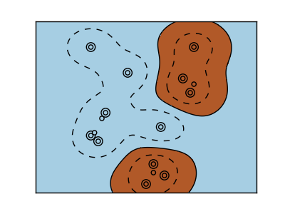
Kernel SVM for Each Relation
Input: Sentence containing entity pair that could share the relation
Sentences of the form
[begin context] [entity 1] [between context] [entity2] [after context]
Context feature vector = average of word2vec vectors
Sentence feature vector = context vectors concatenated
Output:
1 if they do share the relation
-1 if they don’t share the relation
Kernels to begin testing
Linear kernel k(x,y) = x • y
Exp( - || x – y ||² ⁄ 2σ )
Photo Credit: sk-learn.org
Java LIBSVM Refernce :Chang, Chih-Chung, and Chih-Jen Lin. "LIBSVM: a library for support vector machines." ACM Transactions on Intelligent Systems and Technology (TIST) 2.3 (2011): 27.

Slide 35
SVM’s Training (To Do Soon!)
24 relations (need two SVMs each, one for each entity ordering)
User settings
2 Kernels (RBF, linear) to try
4 values of c ∈ {100, 1000, 10000, 100000}
5 values for RBF of γ ∈ { .001, .01, .1, 1, 10}
Up to 7 options for feature vectors (combination of before, between, after context vectors)
5-fold cross-validation
60 % training, 20% development, 20% testing
In all it’s (24*2)*((4*5*7)+(4*7)) = 8,064 SVMs tested on 5 folds each!
Notes:
You might also note that, even though this seems like a lot of SVMs, this also only has to be done once once we’ve got enough training data. We save models trained on the training data using all combinations of these parameters so they can quickly be applied to new documents.

Slide 36
Document Relation Extraction Workflow
Document is parsed
Entities are labeled
Canonicalization (entity names replaced)
Sentence feature vectors created
Calls Word2Vec word feature store
Relations indicated by trained SVM classifier
Relation instance passed to STIX component for inclusion in knowledge graph
Word2Vec word vectors trained offline and stored
Labeled sentence for training done offline and stored
SVM trained offline and stored

Slide 37
Old Vs. New Relation Extraction Approach
Bootstrapping | New Method
Use large corpus | Use large corpus
Use known relation instances | Use known relation instances
 | Use known false relation instances
 | Learn word semantic representations from corpus (Word2Vec)
Learn patterns (rigid rules) from corpus and positive instances (iterative) | Use binary classification (rigid rules replaced by informing features)
Learn relation instances from patterns (iterative)

Slide 38
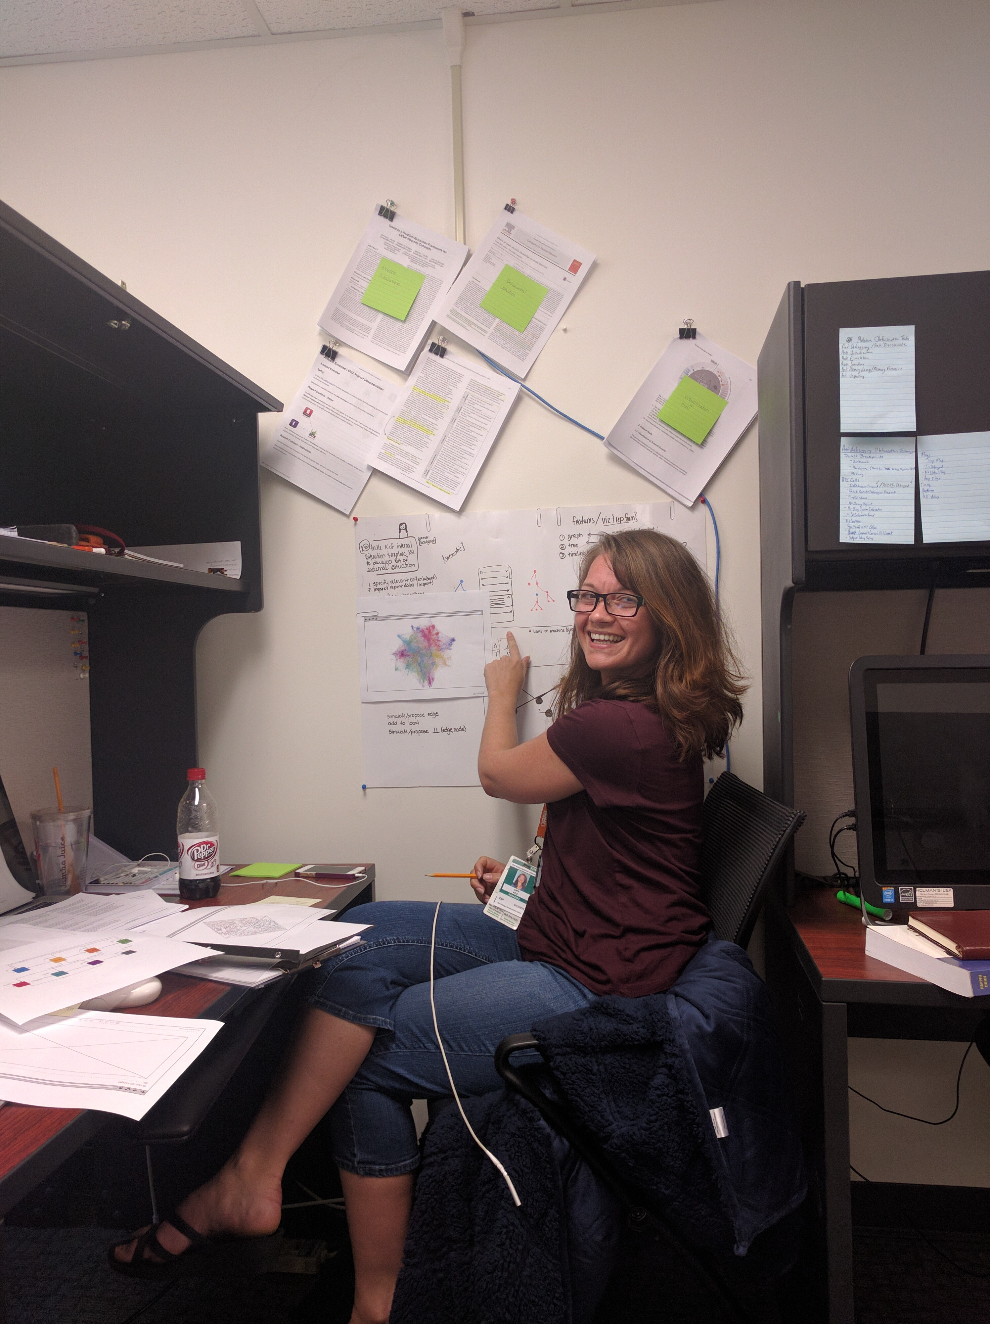
Plans & Near-Future Work
Visualization of the graph to facilitate exploration and modification
DHS-Stem Intern Amy Fox (of UCSD!!!) working on graph visualization ….............→
Linking external data sources
e.g., Splunk
Active Learning Component
Query user for relations learned
Incorporate feedback into learning algorithms (entity & relation extraction)
Publish yet another paper on NLP component
Notes:
Stucco 2.0

Slide 39
Papers and Presentations
Presentation: R.A. Bridges, SIAM AN 2016, Mining Graph Data Minisymposium Invited Presentation, “Multi-level anomaly detection on time-varying graph data with cyber applications”, July 12th.
Presentation: R.A. Bridges, CISRC 2016 conference presentation on GraphPrints Poster, April 5th.
Paper: C.R. Harshaw, R.A. Bridges, M.D. Iannacone, J.R. Goodall, "GraphPrints: Towards a Graph Analytic Method for Network Anomaly Detection”, Cyber and Information Security Research (CISR) Conference, 2016.
This paper received CISRC 2016 Best Short Paper Award

Slide 40
Transition Activities
Stucco is free and open-source (MIT)
Demonstration instance hosted at Stanford
Currently installing within DOE for testing
Planning pilot deployments at
ORNL
Stanford
Other organizations have expressed interest (Navy Cyber Defense Operations Command, Dutch National Cyber Security Center)
Digital Reasoning has contacted us about using open-source NLP developments
We are looking for other pilot sites

Slide 41
Benefits
Analysts have accurate, relevant, and timely contextual information readily available
Less time searching for data → more time doing analysis
More context → better analysis and decisions
Analytics on knowledge graph can lead to new insights
Other security systems can leverage the open API
Security community can leverage tools and data

Slide 42

Contact Information
Robert A. Bridges
bridgesra@ornl.gov
Michael D. Iannacone
iannaconemd@ornl.gov
PI: John Goodall
jgoodall@ornl.gov
865-446-0611
@johnrgoodall
https://stucco.github.io/

